Slide 1
GEOMETRY (Intermediate)
Zobayer Hasan

Slide 2
Line, Ray and Segment

Slide 3
Line, Ray and Segment
Equation
Parallel
Perpendicular
Intersection
Determinant

Slide 4
Line, Ray and Segment
What if we don’t need the intersection point?
Segment – Segment Intersection

Slide 5
Line, Ray and Segment
Segment – Segment Intersection
Left or Right?

Slide 6
Line, Ray and Segment
inline bool intersect(const Point &p1,
const Point &p2,
const Point &p3,
const Point &p4) {
i64 d1, d2, d3, d4;
d1 = direction(p3, p4, p1);
d2 = direction(p3, p4, p2);
d3 = direction(p1, p2, p3);
d4 = direction(p1, p2, p4);
if(((d1 < 0 && d2 > 0) || (d1 > 0 && d2 < 0))
&& ((d3 < 0 && d4 > 0) || (d3 > 0 && d4 < 0))) return true;
if(!d3 && onsegment(p1, p2, p3)) return true;
if(!d4 && onsegment(p1, p2, p4)) return true;
if(!d1 && onsegment(p3, p4, p1)) return true;
if(!d2 && onsegment(p3, p4, p2)) return true;
return false;
}
Segment – Segment Intersection,
without solving equation?
How to find if a point lies on a
segment?
https://zobayer2009.wordpress.com/code/#segintersect

Slide 7
Segment and Lattice Points
How many lattice points lie on a segment?

Slide 8
Polygons
Simple Polygons

Slide 9
Polygons
Area
Center of Mass

Slide 10
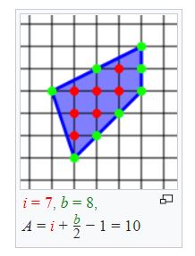
Pick’s Theorem
UVA 10088 - Trees on My Island
https://en.wikipedia.org/wiki/Pick%27s_theorem
https://en.wikipedia.org/wiki/Centroid#Centroid_of_a_polygon

Slide 11
Point Inside Polygon
How many times will the ray intersect?
Ray shooting

Slide 12
Bisection (Binary Search)

Slide 13
Bisection
LightOJ 1196 – Inhabitants
Point inside convex polygon?
https://zobayer2009.wordpress.com/code/#in_convex

Slide 14
Bisection
LightOJ 1137 – Expanding Rods
Why waste time trying to find the formula
Use bisection to eliminate one unknown variable.

Slide 15
Ternary Search
Used to find peak or bottom.

Slide 16
Ternary Search
Farthest Pair of Points in a Convex Polygon
Will algorithm similar to finding tree diameter work for this?

Slide 17
Ternary Search
Point and Segment distances
LightOJ 1146 and LightOJ 1240
Hint: Parametric Equation
2D, 3D?

Slide 18
Convex Hull
Graham’s Scan
Find an extreme point, let’s call it origin.
Sort all the points based on tangent from selected origin.
Start a stack with first three points
For each of the next points
If this point is a CW turn from top two points in stack, then the point in stack top must be popped. Continue till you find a CCW turn.
If not, this point will be pushed in the stack and we move on to next point.
When all the points are processed, the stack will contain the convex hull in CCW order.
https://zobayer2009.wordpress.com/code/#convex_hull

Slide 19
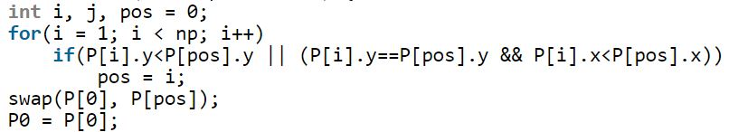
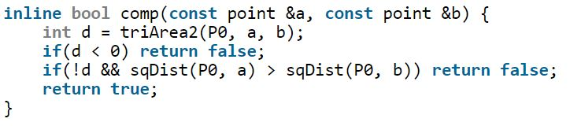
Convex Hull
Graham’s Scan
Finding extreme point
Sorting

Slide 20
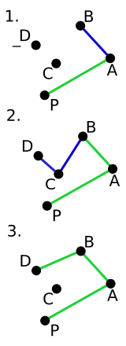
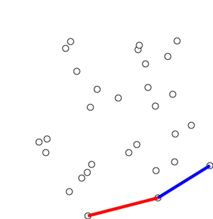
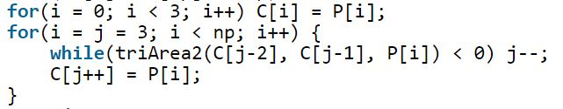
Convex Hull
Graham’s Scan
The Stack
Things to be careful about
Co-linear points
https://en.wikipedia.org/wiki/Graham_scan

Slide 21
Convex Hull
LightOJ 1203 – Guarding Bananas
Find the minimum angle
LightOJ 1239 – Convex Fences
Find convex hull of circles of same radius
LightOJ 1285 – Drawing Simple Polygon
Just the polar sorting
Tangent from an external point
Farthest pair of points
Common area of two convex polygons

Slide 22
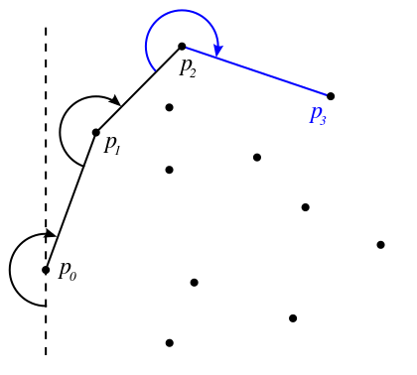
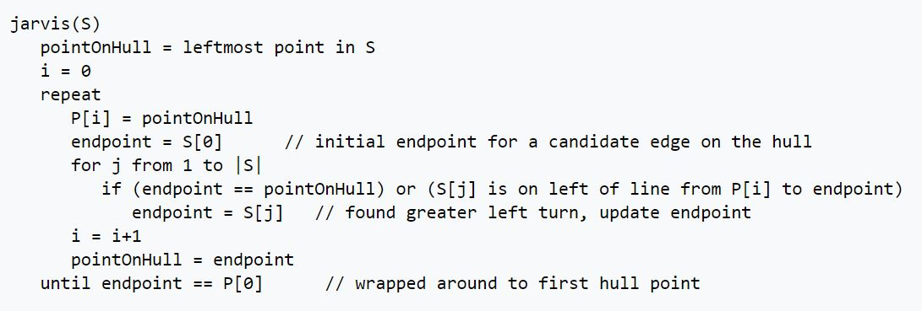
Convex Hull
Gift Wrapping / Jarvis’ March
https://en.wikipedia.org/wiki/Gift_wrapping_algorithm
O(nh) algorithm.

Slide 23
Convex Hull
Jarvis’ March
Find the minimum fence around circles of variable radii.
Do you remember how to find a tangent
Between two circles?

Slide 24
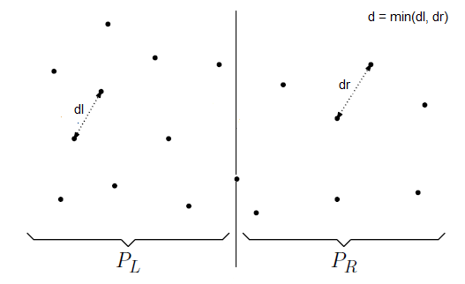
Closest Pair of Points
Divide and Conquer.
http://www.geeksforgeeks.org/closest-pair-of-points/
https://zobayer2009.wordpress.com/code/#closest_pair
Algorithm Steps
Sort the points based on their X-coordinate.
Recursively find closest distance from left and right sub arrays. Let this value be d.
Before returning result, we have to consider a special case around the middle point.

Slide 25
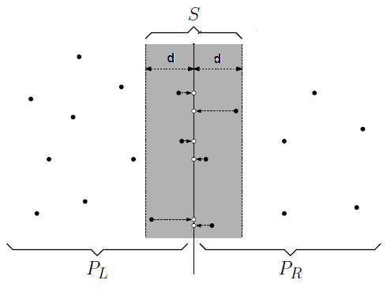
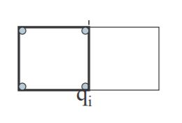
Closest Pair of Points
We know that the distance cannot be more than d. So we collect all points at most d distance on both sides from the middle point.
Sort these points and find smallest distance d1 among these points.
Return minimum of d and d1.
Note: Within d distance from the middle
point, there can be at most 7 other points.
Proof?
http://www.spoj.com/problems/CLOPPAIR/

Slide 26
Angle Between Vectors
Can be determined by dot product

Slide 27
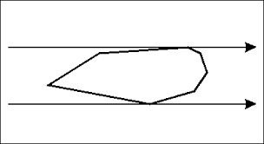
Rotating Calipers
Support Lines
Antipodal Points
Calipers
More than one caliper
More than one polygon
Linear time

Slide 28
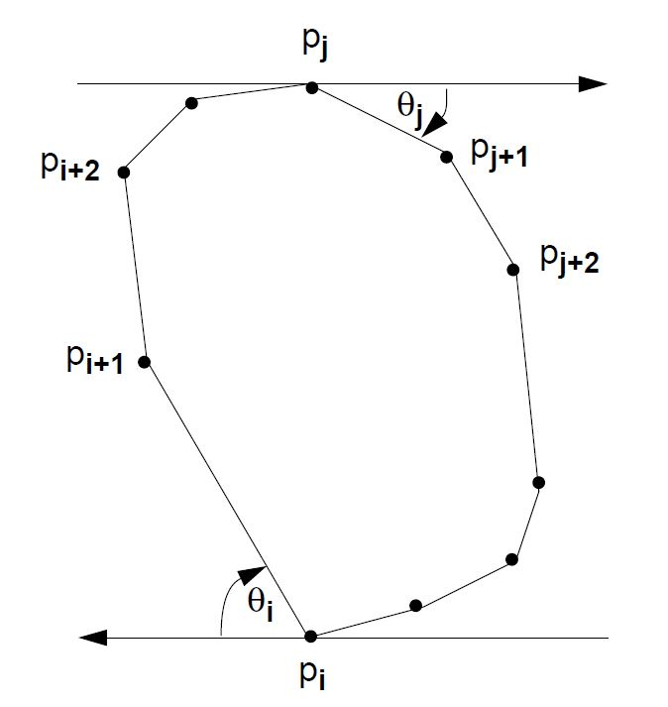
Rotating Calipers
Diameter of a Convex Polygon
Complexity?
Algorithm
Select Pi arbitrarily and for the support line on Pi, find antipodal pair Pj in O(n).
Keep rotating the calipers each time by the lowest amount of angle between Өi and Өj.

Slide 29
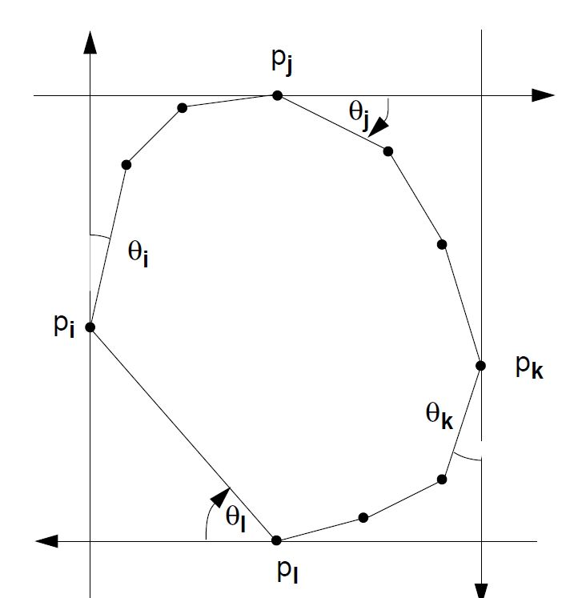
Rotating Calipers
Minimum area enclosing rectangle of a convex polygon.
Use two pairs of calipers.
UVA 12307
UVA 10173

Slide 30
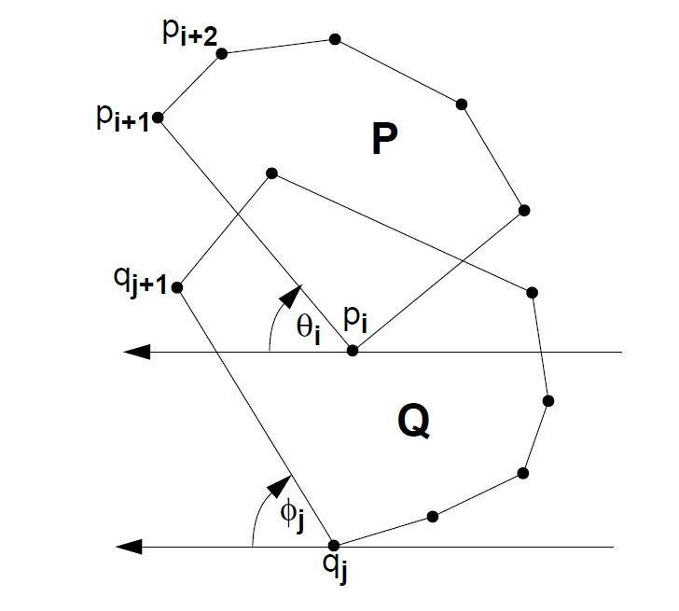
Rotating Calipers
Maximum Distance Between Two Convex Polygons
Can this be done for more?
Complexity?

Slide 31
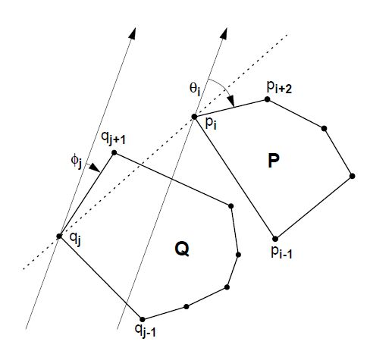
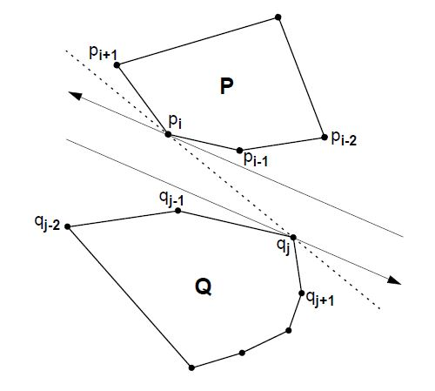
Rotating Calipers
Bridge Lines
Merging Convex Polygons in O(n)
Critical Support Lines
Finding Visibility

Slide 32
Thank You

